Slide 1
Critical Information Systems Updates at GOHSEP
Louisiana Emergency Management Conference Wednesday, May 10, 2023

Slide 2
Overview
Critical Information Systems
2023 Goals and Projects
WebEOC and WebEOC App Demo
VLA and Survey123 Demo
Moving Forward

Slide 3





Critical Information Systems
Critical Information Systems (CIS) at GOHSEP refer to the different software and applications used to assist with planning, response, and recovery.
WebEOC, ArcGIS, Virtual Louisiana, ReadyOp, and Survey123

Slide 4
WebEOC
WebEOC is a web-based, incident management system.
You don’t need to be inside a GOHSEP or State network in order to access WebEOC.
You can log in from any device as long as you have a working username and password.
WebEOC is used for many processes including situation reports, resource requests, file management, shelter and POD statuses, event scheduling, and much more.

Slide 5
WebEOC
GOHSEP has used WebEOC for incident management since late 2000s.
Approximately 1,800 users from 64 parishes, 30+ state agencies, federal agencies, and other partners.
On average, the State EOC or Crisis Action Team activated for a little over 60 days and 35 WebEOC incidents each year.
In 2023, we are a little above the average rate with 19 incidents going into May.

Slide 6
Virtual Louisiana
Virtual Louisiana (VLA) serves as a common operational picture for the Louisiana emergency response community and is used for daily operations, planning, and emergency response and recovery.
The original version of Virtual Louisiana was introduced in 2008 and used the Google Earth desktop client.
A web-based version, VL2, was developed in 2016 and included interactive features.

Slide 7
Virtual Louisiana
The current version of VLA was developed in 2020 using the ArcGIS Hub Premium platform.
What is the new version of VLA used for?
Share newly-developed data, maps, and apps from GOHSEP to state and parish users
Grant users the ability to upload, share, and create their own GIS content
Make archived and cataloged data readily available
We have over 260 VLA users with capacity for many more.

Slide 8
ReadyOp
ReadyOp is a communications dashboard used by GOHSEP.
Its primary uses include sending out mass phone, text, and e-mail alerts and creating and managing online forms. Its flexibility has allowed us to use it for many situations.
Messaging for UMR and ESF staff
COVID resource management
Notifications to statewide partners when state networks are down
Contact management for RAVE Alerts
E-mails are from notifications@la.readyop.com.

Slide 9
ArcGIS Online
Virtual Louisiana is an extension of the GOHSEP ArcGIS Online Organization
Limited GOHSEP staff have access to the GOHSEP ArcGIS Online website. This includes operations, preparedness, and executive staff who need additional user or administrator access.
Individual Assistance team members for PDA reviewing
Operations staff to share content within the State EOC
Regional Support for local coordination

Slide 10
ArcGIS Online
While access is limited, much of the content created here is added to the Virtual Louisiana library and is available to VLA users.
For 2023, we’ve moved many viewer- and fieldworker-level accounts to Virtual Louisiana in order to create more publisher accounts within ArcGIS. This will go into effect in June.

Slide 11
Survey123
Survey123 is a form-based, data-gathering tool developed by Esri.
Forms are accessible on both desktop and mobile devices.
Submitted forms are added to a live dataset.
When using the Survey123 app, form submissions can be saved and later uploaded if a live connection isn’t available.

Slide 12
Survey123
Survey123 is a key component of the state’s Individual Assistance (IA) damage assessment process.
VLA users have access to special Survey123 forms, allowing them to perform their choice of quick or detailed windshield damage assessments. These forms can also be shared with any assisting first-responder personnel.
This data is immediately available for parish agency download and use. It’s also submitted to GOHSEP for expedited review.

Slide 13
2023 Goals and Projects

Slide 14
2023 Goals
Introduce the WebEOC mobile app to users
Begin populating boards into the WebEOC app
Develop new GIS content and resources that are mobile-friendly
Make all WebEOC data transfer into ArcGIS Online for use in VLA

Slide 15
2023 Goals
Introduce the WebEOC mobile app to users
Introduced the app at the LEMC Winter Workshop in January
Begin populating boards into the WebEOC app
Develop new GIS content and resources that are mobile-friendly
Make all WebEOC data transfer into ArcGIS Online for use in VLA

Slide 16
2023 Goals
Introduce the WebEOC mobile app to users
Introduced the app at the LEMC Winter Workshop in January
Begin populating boards into the WebEOC app
CIS Support Request and AAR Board available with more to follow
Develop new GIS content and resources that are mobile-friendly
Make all WebEOC data transfer into ArcGIS Online for use in VLA

Slide 17
2023 Goals
Develop new GIS content and resources that are mobile-friendly
Make all WebEOC data transfer into ArcGIS Online for use in VLA

Slide 18
2023 Goals
Develop new GIS content and resources that are mobile-friendly
Developing EMGIS toolkit in VLA with feedback from parish OHSEP staff
Building new dashboards using ArcGIS Experience Builder for better mobile viewing
Make all WebEOC data transfer into ArcGIS Online for use in VLA

Slide 19
2023 Goals
Develop new GIS content and resources that are mobile-friendly
Developing EMGIS toolkit in VLA with feedback from parish OHSEP staff
Building new dashboards using ArcGIS Experience Builder for better mobile viewing
Make all WebEOC data transfer into ArcGIS Online for use in VLA
Shelters, PODs, and ETHA waivers established in VLA
Resource requests, agency and regional contact info, declarations, and school closures to follow

Slide 20
WebEOC App and Demo
New board walkthrough on desktop
Logging in and using the WebEOC app

Slide 21
VLA and Survey123 Demo
Logging in to VLA, searching for data, accessing Teams content
Using Survey123 to perform IA damage assessments

Slide 22
Moving Forward
We’ve used these systems to change and improve emergency management response in Louisiana over the last few years and will continue to do so.
Improved executive briefings for situational awareness
Expedited damage assessment reporting and review
Greater data accessibility for all stakeholders
Your feedback is critical and highly-valued.

Slide 23
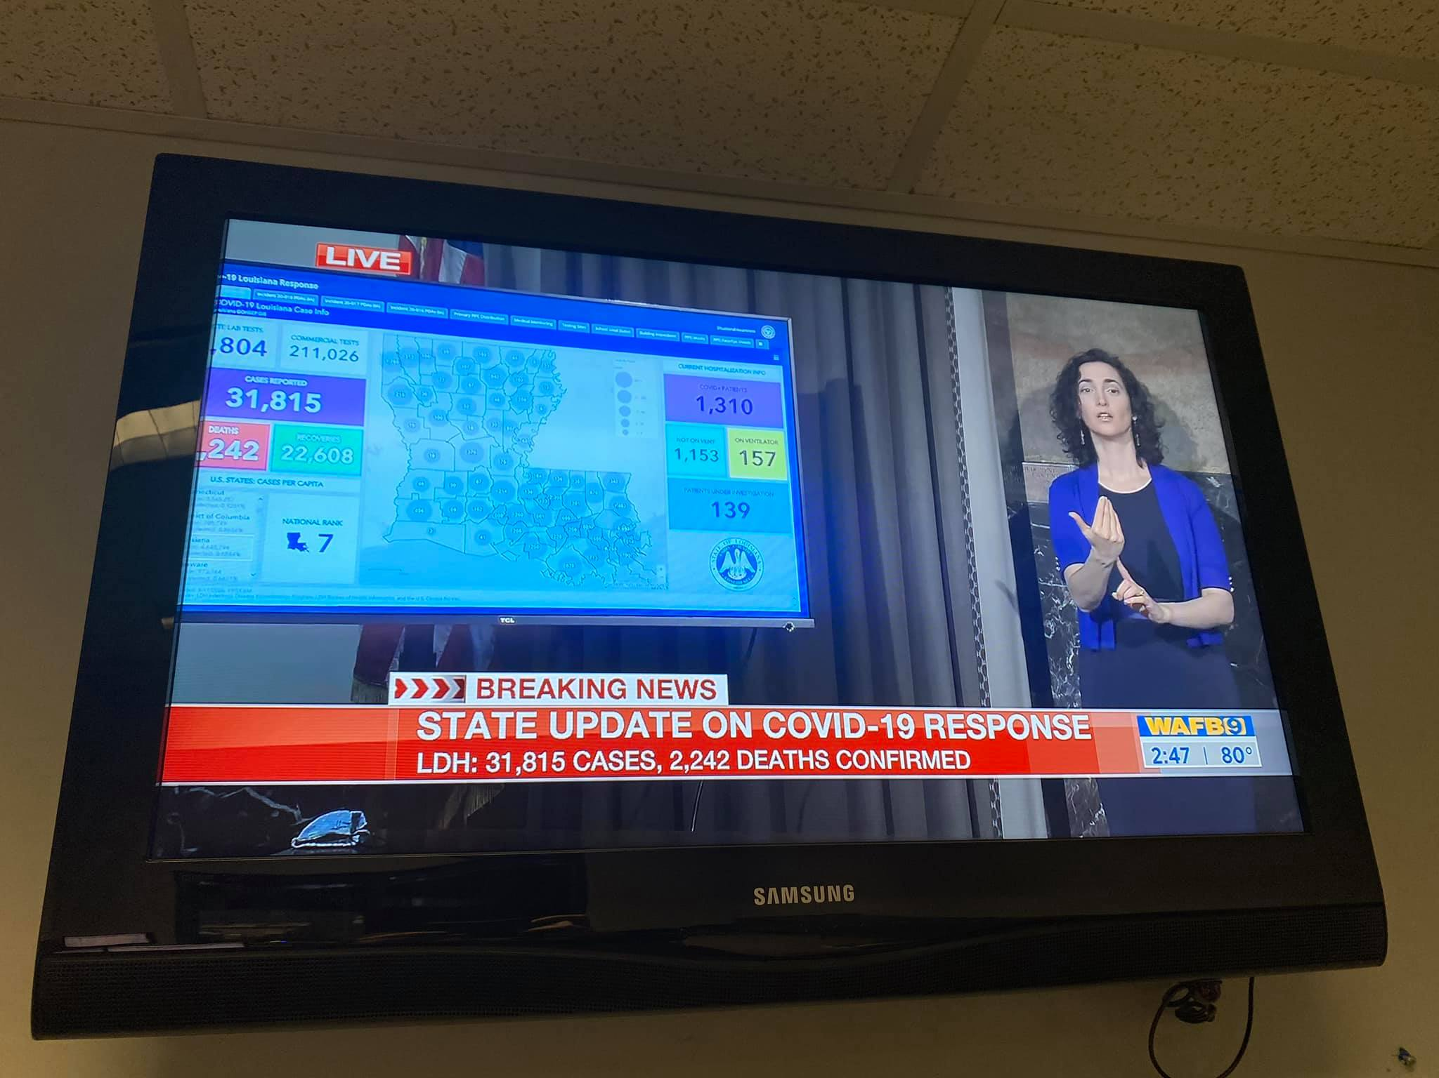

Slide 24
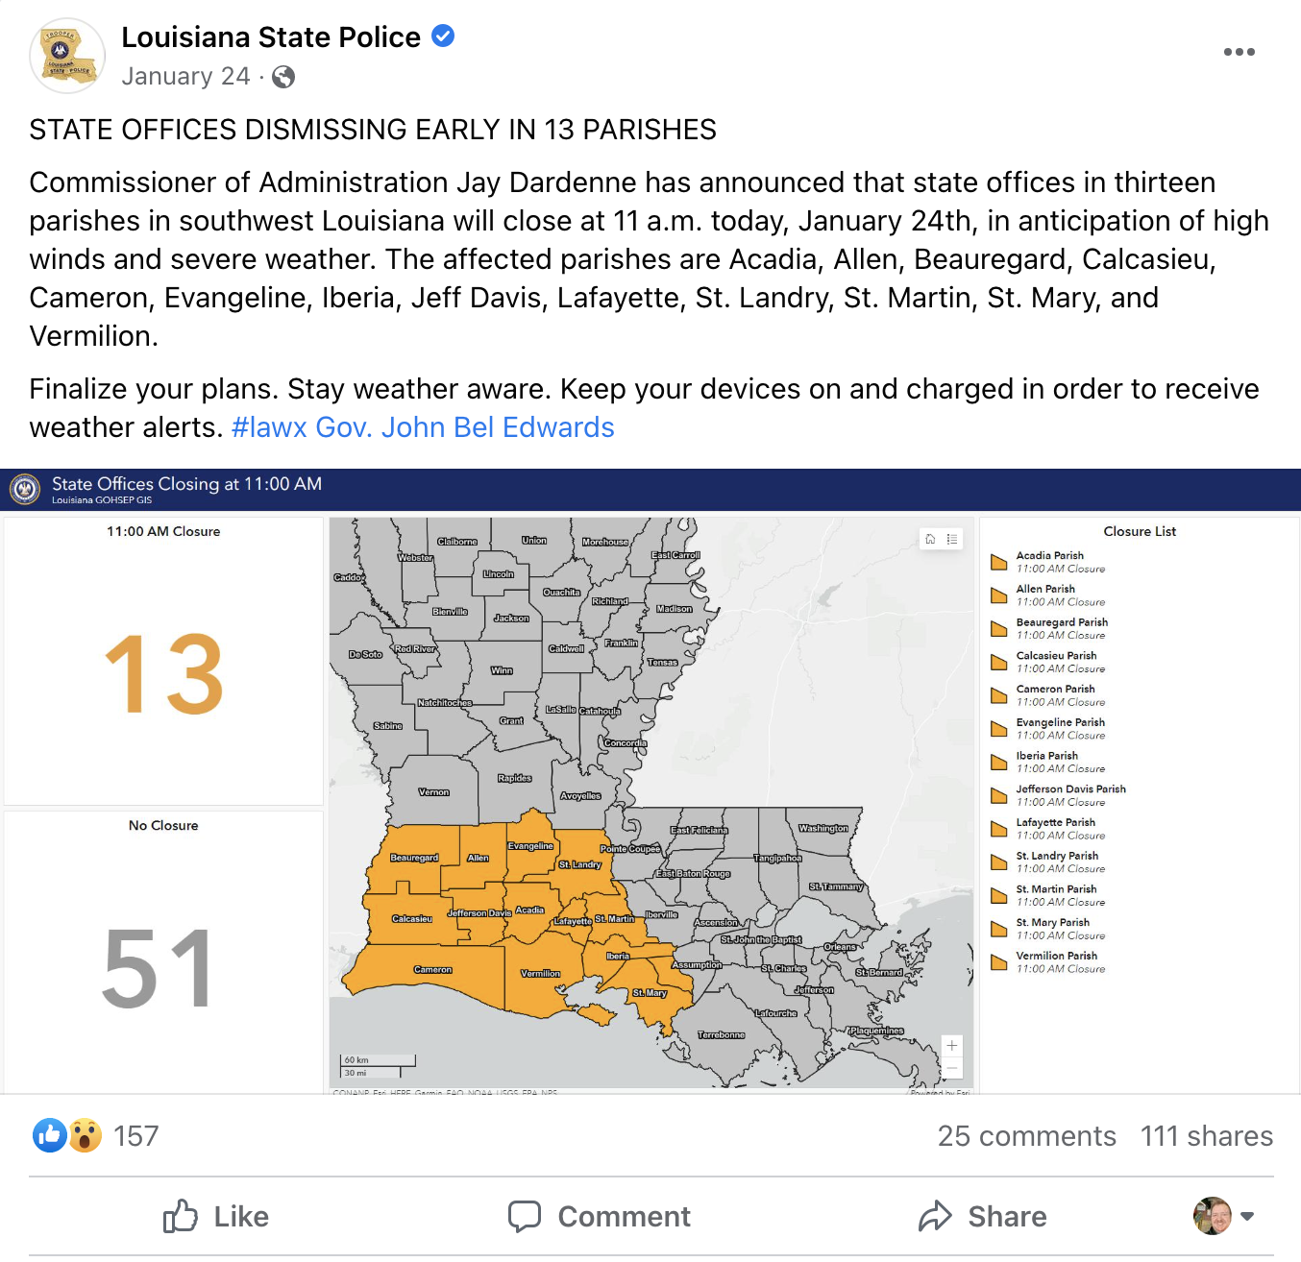

Slide 25
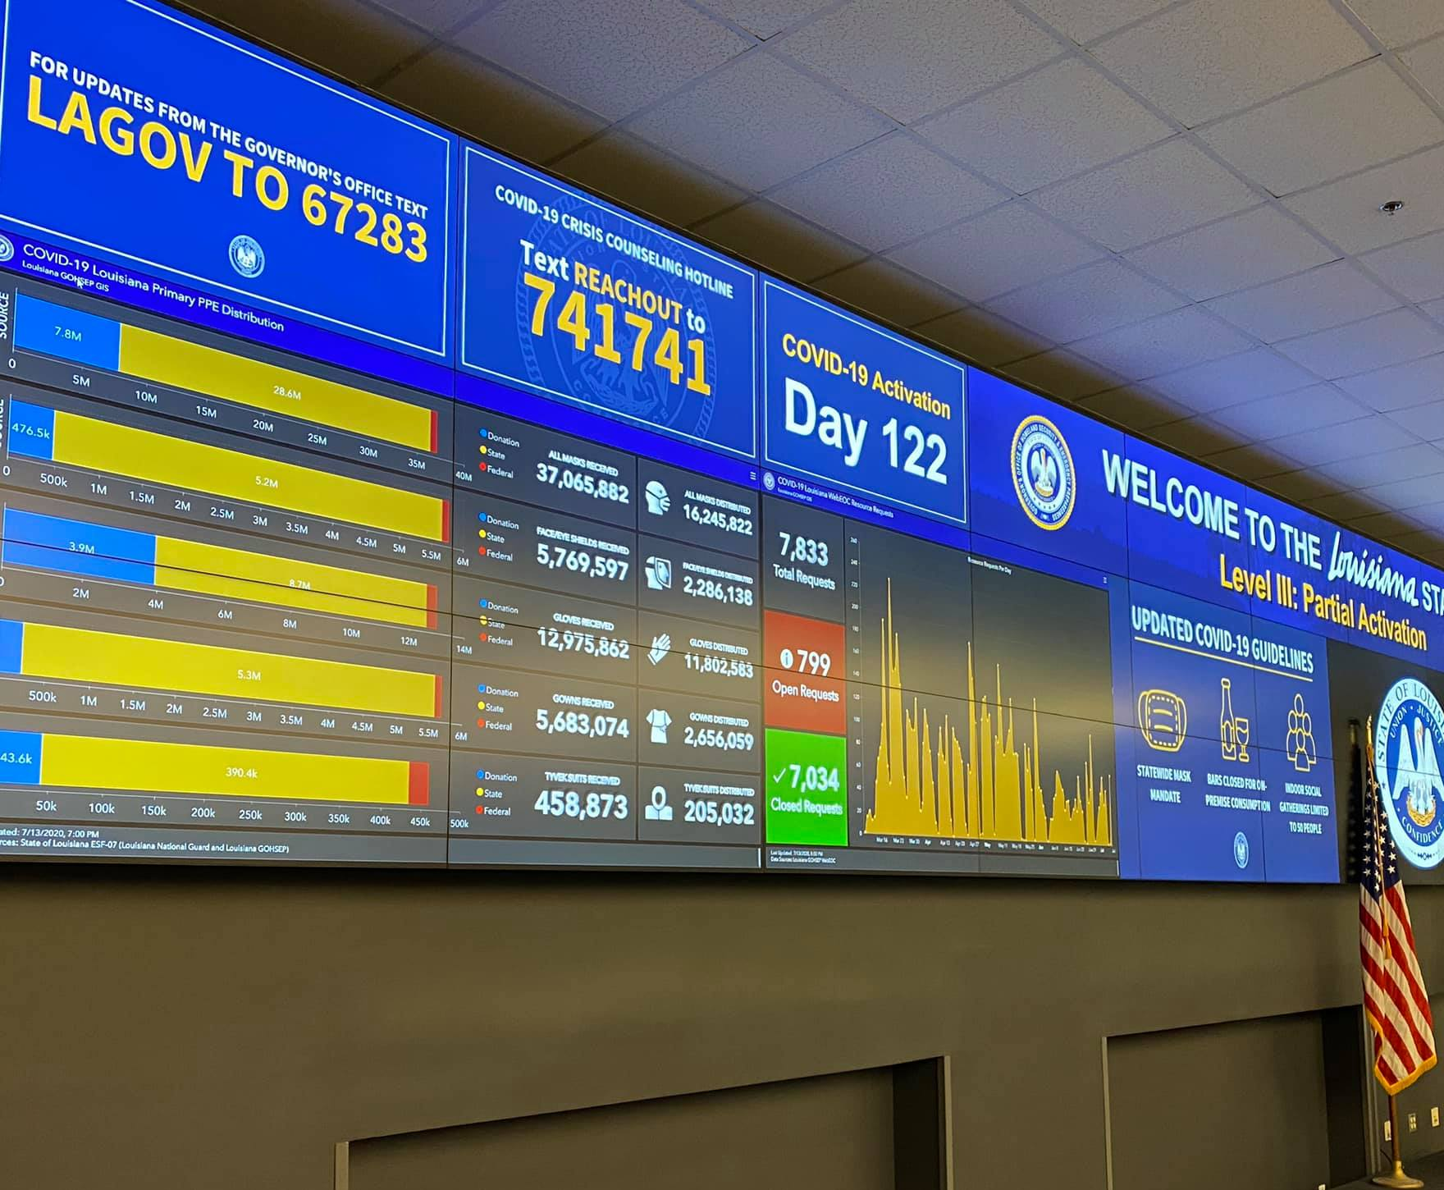

Slide 26
Moving Forward
Training is available for these systems at http://stems.gohsep.la.gov/.
WebEOC-100: Intro to WebEOC
WebEOC-200: Intermediate WebEOC (multiple version for different user groups)
VLA-100: Intro to Virtual Louisiana
CIS-200: Critical Information Systems for Mobile Devices

Slide 27
Contact Info
Austin Dixon, PWA
WebEOC Administrator
Louisiana Governor’s Office of Homeland Security & Emergency Preparedness
Phone: (225) 922-2190
E-Mail: Austin.Dixon@la.gov

